Slide 1
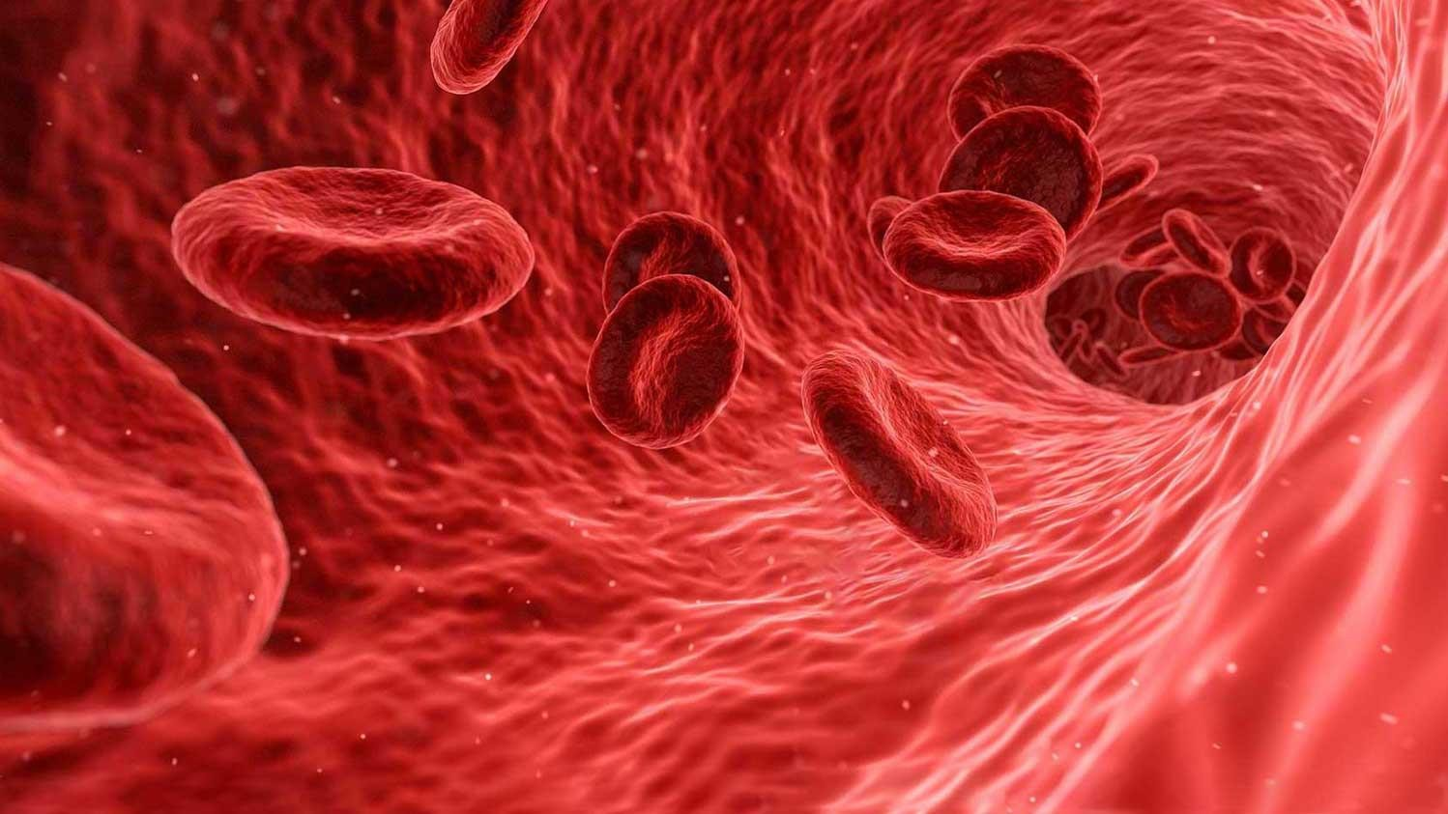



2020-1-RO01-ESC11-079372
DONATE BLOOD, DONATE LIFE!

Slide 2
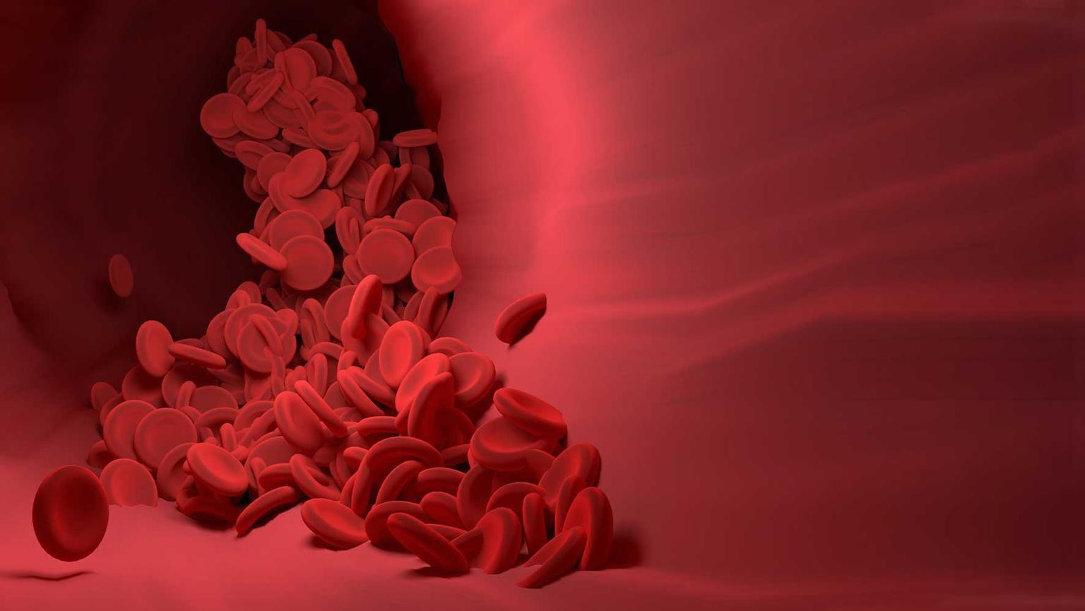
The objectives of the project are the following:
AIMS AND OBJECTIVES OF THE PROJECT
Developing useful skills for employability as well as a healthy lifestyle among 20
young people from 9 countries
Promoting the importance of blood donation among over 6000 people
Promoting the harmful effects of drug use among over 600 high school students
You do not have to be a doctor to save lives – donate blood.

Slide 3
Timeline of the project
STAGE 2
Stage starting date: 01.09.2020
Stage ending date: 30.10.2020
STAGE 1
Stage starting date:
01.07.2020
Stage ending date: 30.08.2020
Blood donation campaign
Blood donation
campaign
01.07.2020
30.08.2020
30.10.2020
STAGE 1
STAGE 2
Eligibility of the project: 01.06.2020 – 30.11.2021

Slide 4


What we need?
Volunteers
Countries eligible for STAGE 1
Countries eligible for STAGE 2
EU countries + Georgia, Moldova, North Macedonia, Ukraine.
The distribution will be : 8 international volunteers + 2 Romanian volunteers
EU countries + Georgia, Moldova, North Macedonia, Ukraine.
The distribution will be : 8 international
volunteers + 2 Romanian volunteers

Slide 5

What we search:
Youth aged 18 to 30 years old
Fluent in English, both speaking and writing
Motivated to take part in a 2 month ESC with the topic of blood donation
Previous experience in volunteering may be considered a plus
Youth with few opportunities (unemployed, not in school, few financial possibilities, cultural obstacles, refugees etc). PRIORITY WILL BE GIVEN TO THIS CATHEGORY
Volunteer profile
In case of interest WHAT YOU NEED TO SEND US
CV in EUROPASS FORMAT
https://europass.cedefop.europa.eu/documents/curriculum-vitae
MOTIVATION LETTER – adapted on the topic of the project, from which we want
to see how you consider can add a value to the project
Valid passport or ID (for EU citizens)
ABILITY TO BUY THE TRAVEL TICKETS (at arrival reimbursement will be made)

Slide 6
BLOOD DONATION CAMPAIGN
Promotion at local level of blood donation through posters, flyers etc
PUBLIC EVENTS
To raise awareness about the importance of blood donation
WHAT YOU WILL DO HERE
JOURNALISTIC ACTIVITIES
To document your ESC experience and promote ESC for other youth
RED BRACELET CLUB
Register youth from the community in the club for support at local level
SOLIDARITY SUPPORT FOR THE COMMUNITY
Other activities decided between the association and the volunteers for the benefit of the community

Slide 7
BLOOD DONATION ACTIVITIES
Social media campaigns about raising awareness of the need for blood
Promote in the community the blood donation and the steps to be follow to donate blood
Blood donation campaigns
Videos to promote blood donation

Slide 8


Volunteers will be guided in the activities by a coordinator.
Volunteers will be assisted to register to OAT and MTM (organized by NA) where is mandatory to take part.
Volunteers will be offered a travel support according to the travel band distance.
Volunteers will have to fill and send at the end of each month anactivity report. At the end of
the stage volunteers must fill the report from The Mobility Tool.
Volunteers are expected to work 6 hours/day, 5 days/week. 2 freedays/month. NOTE: weekend activities(events) can be possible.
According to the program rules: 2 holidays/month will be granted. The Romanian free declared Holidays will be applied also to volunteers (Christian Orthodox Easter/Christmas, National Independence day etc)
Volunteers will have to sign an agreement where are stipulated their tasks,
rights and
responsibilities.
Volunteers will be accommodated in apartments fully equipped, 2/room each gender, with
shared bathroom and kitchen.
Volunteers will receive a monthly food allowance of 150 euros and 90 euros pocket money in
Lei (Romanian currency) at the monthly rate exchange.
Volunteers will be assigned a mentor, weekly meetings are encouraged to be attended in order
to evaluate the learning process.
Language support will be provided based on the grant received.
A monthly local travel bus pass will be provided for each volunteer.
ESC Organizational aspects

Slide 9
Indicators of the project
20 youthpass certificates
elements of visual identity of the project
updated project web address and Facebook page
2 blood donation campaigns in Craiova and 2 other blood donation
campaigns in other localities
4 public blood donation awareness events
2 motivational photo exhibitions for healthy living
2 stands for promoting ESC opportunities
3 action plans of the Red Bracelet Club 2
2 media appearances
E-Magazine brochure that will include 2 numbers (1 issue / month)
2 brochures for donors
20 interviews with key people from the community
20 general articles
at least one appearance in the AN publication at the end of the project
20 posts in youth networks
20 local actions - each one an action to promote the results of the project performed by each volunteer - each one an
event realized by each volunteer
1 major event to promote the cumulative results of the project realized by ANDCTR at the University of Craiova

Slide 10
MENTORSHIP
During the project besides the PROJECT COORDINATOR,
a FACILITATOR of the activities and the specialists from the day center where you will develop the activities, you will also have a support person that will help you to adapt, to integrate and will guide your learning process during the project. This person is chosen by the hosting organization and is called MENTOR.
Mentorship can be defined as the set of relations and processes that appear between an ESC volunteer and the person who facilitates the learning process during the project
The mentorship can be described as:
Facilitating the learning process.
Introducing the volunteer to the local community.
Advising or counseling the volunteer in difficult situations.
Helping the volunteer to realize his achievements gained through the activities.
The mentors figure is very important in the whole process because he assists the volunteer to integrate, to develop himself and to overcome possible difficulties.
The mentor can help the volunteer to identify the strong and weak points regarding his skills and personality.
Each volunteer will be assigned a mentor and will benefit from group and individual mentorship sessions.
YOU
NEEDS, WANTS, GOALS
Your Mentor
SUPPORT, GUIDE, MOTIVATE

Slide 11


HOSTING COMMUNITY
CRAIOVA
INFO ABOUT THE CITY
https://en.wikipedia.org/wiki/Craiova
https://www.youtube.com/watch?v=w9De8DmGjpM
https://www.youtube.com/watch?v=2xWsWJxdEi4
https://www.youtube.com/watch?v=rwB5jgxGD48
https://www.youtube.com/watch?v=_E5IuqOMdnk

Slide 12

ACCOMMODATION
Living conditions
Volunteers will be accommodated in a students dormitory, 3-4 / room, same gander room, will share a kitchen at the end of the hall way, with shared bathoom.
Will be provided:
1 set of bed sheets, 1 pillow, 1 blanket /volunteer
Cutleries, pans and other neccessities for cooking to be shared between the volunteers (kitchen equipements will be basic)
Washing machine to be shared

Slide 13


H O W TO A R R I V E
T O C R A I O V A
2 By plane to Craiova International Airport ( mainly for Spain, Italy, France, Germany and UK )
1 By plane to Bucharest Otopeni “Henri Coanda” Airport
Exit the terminal (do NOT forget your luggage)
Take the bus to Craiova, reservations can be made online
https://mementobus.com/
- you can pay in Romanian currency at the driver or on-line
on the website
3 By bus to the city center

Slide 14
THANK YOU
HOPE TO SEE YOU IN CRAIOVA

